Slide 1
Outline
Definition of a tree data structure and its components
Concepts of:
Root, internal, and leaf nodes
Parents, children, and siblings
Paths, path length, height, and depth
Ancestors and descendants
Ordered and unordered trees
Subtrees
Examples
XHTML and CSS

Slide 2
Define Tree.

Slide 3
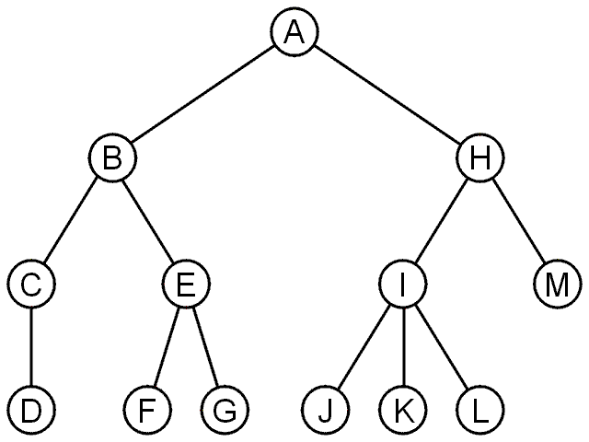
Trees
A rooted tree data structure stores information in nodes
There is a first node, or root
Each node has references to successors

Slide 4
Definition of Trees
A tree is a data structure. It is used for
storing files
text processing
searching algorithms
A tree can be defined non-recursively or recursively.

Slide 5
Tree
Non-recursive definition: A tree consists of a set of nodes and a set of directed edges that connect pairs of nodes.
One node is distinguished as the root
Every node c, except the root, is connected by an edge from exactly one other node p. Node p is c’s parent, and c is one of p’s children
A unique path traverses from the root to each node. The number of edges that must be followed is the path length.
A leaf is a node that has no children.

Slide 6
Tree
A recursive definition of a tree
Either a tree is empty or it consists of a root and zero or more nonempty sub-trees T₁, T₂, ..., T_{k} each of whose roots are connected by an edge from the root.

Slide 7
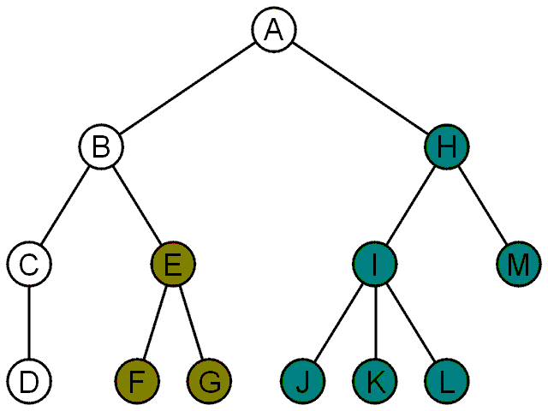
Terminology
Another approach to a tree is to define the tree recursively:
A degree-0 node is a tree
A node with degree n is a tree if it has n children and all of its children are disjoint trees (i.e., with no intersecting nodes)
Given any node a within a tree with root r, the collection of a and all of its descendants is said to be a subtree of the tree with root a

Slide 8
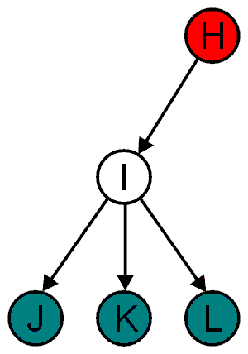
Terminology
All nodes will have zero or more child nodes or children
I has three children: J, K and L
For all nodes other than the root node, there is one parent node
H is the parent I

Slide 9
Terminology
The degree of a node is defined as the number of its children: deg(I) = 3
Nodes with the same parent are siblings
J, K, and L are siblings

Slide 10
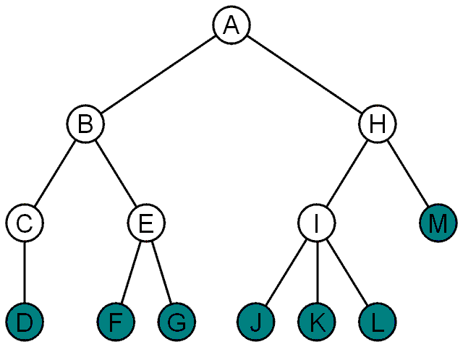
Terminology
Nodes with degree zero are also called leaf nodes
All other nodes are said to be internal nodes, that is, they are internal to the tree

Slide 11
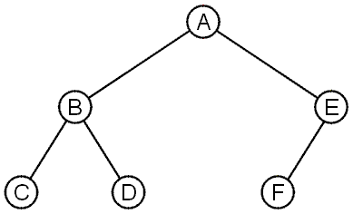
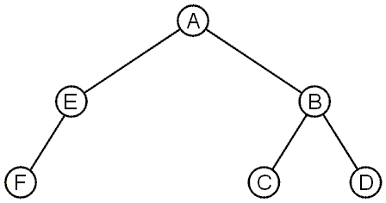
Terminology
These trees are equal if the order of the children is ignored
unordered trees
They are different if order is relevant (ordered trees)
We will usually examine ordered trees (linear orders)
In a hierarchical ordering, order is not relevant

Slide 12
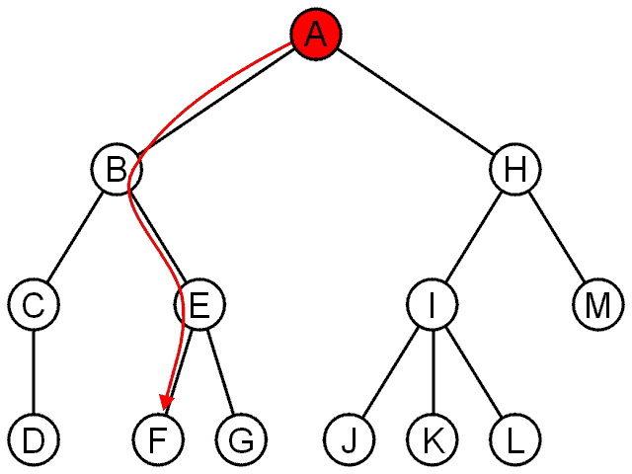
Terminology
The shape of a rooted tree gives a natural flow from the root node, or just root

Slide 13
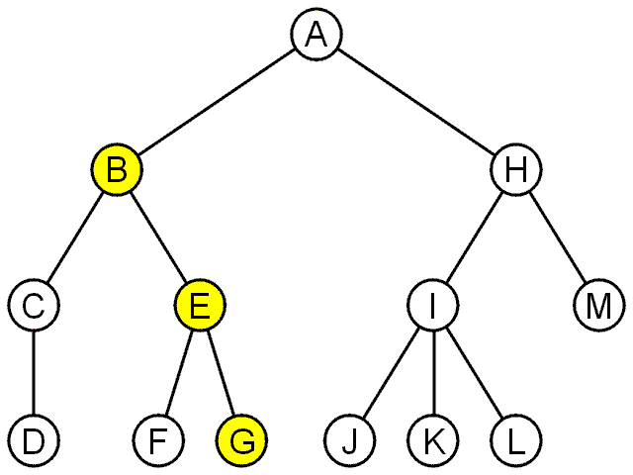
Terminology
A path is a sequence of nodes
(a₀, a₁, ..., a_{n})
where a_{k + 1} is a child of a_{k} is
The length of this path is n
E.g., the path (B, E, G) has length 2

Slide 14
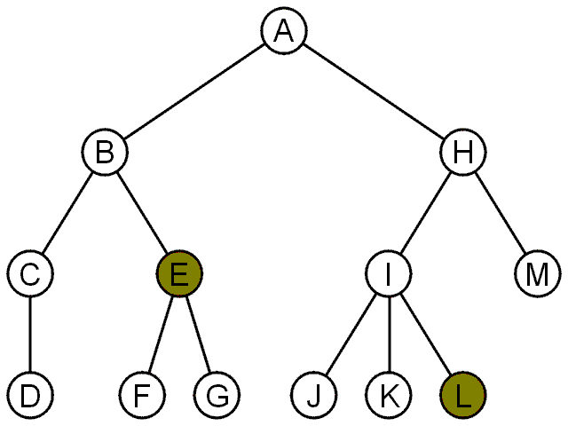
Terminology
For each node in a tree, there exists a unique path from the root node to that node
The length of this path is the depth of the node, e.g.,
E has depth 2
L has depth 3

Slide 15
Terminology
The height of a tree is defined as the maximum depth of any node within the tree
The height of a tree with one node is 0
Just the root node
For convenience, we define the height of the empty tree to be –1

Slide 16
Terminology
If a path exists from node a to node b:
a is an ancestor of b
b is a descendent of a
Thus, a node is both an ancestor and a descendant of itself
We can add the adjective strict to exclude equality: a is a strict descendent of b if a is a descendant of b but a ≠ b
The root node is an ancestor of all nodes

Slide 17
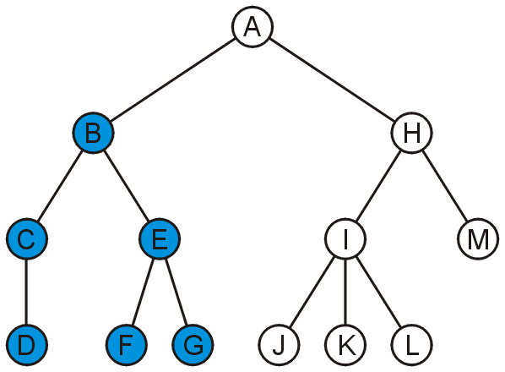
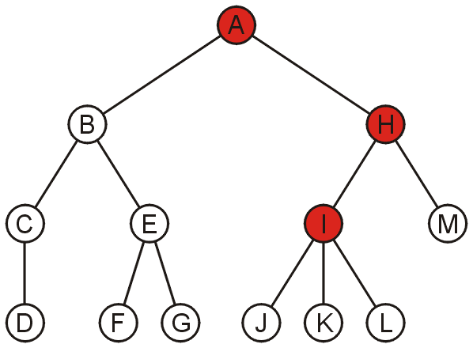
Terminology
The descendants of node B are B, C, D, E, F, and G:
The ancestors of node I are I, H, and A:

Slide 18
Tree Properties
Property Value
Number of nodes
Height
Root Node
Leaves
Interior nodes
Number of levels
Ancestors of H
Descendants of B
Siblings of E
A
B
C
D
E
F
G
H
I

Slide 19
Tree Properties
Property Value
Number of nodes 9
Height 4
Root Node A
Leaves C,D,F.H.I
Interior nodes A,B.E,G
Number of levels 5
Ancestors of H G
Descendants of B D,E,F
Siblings of E D,F
A
B
C
D
E
F
G
H
I

Slide 20
Example: XHTML and CSS
The XML of XHTML has a tree structure
Cascading Style Sheets (CSS) use the tree structure to modify the display of HTML

Slide 21
Example: XHTML and CSS
Consider the following XHTML document
<html>
<head>
<title>Hello World!</title>
</head>
<body>
<h1>This is a <u>Heading</u></h1>
<p>This is a paragraph with some
<u>underlined</u> text.</p>
</body>
</html>

Slide 22
Example: XHTML and CSS
Consider the following XHTML document
<html>
<head>
<title>Hello World!</title>
</head>
<body>
<h1>This is a <u>Heading</u></h1>
<p>This is a paragraph with some
<u>underlined</u> text.</p>
</body>
</html>
title
heading
body of page
underlining
paragraph

Slide 23
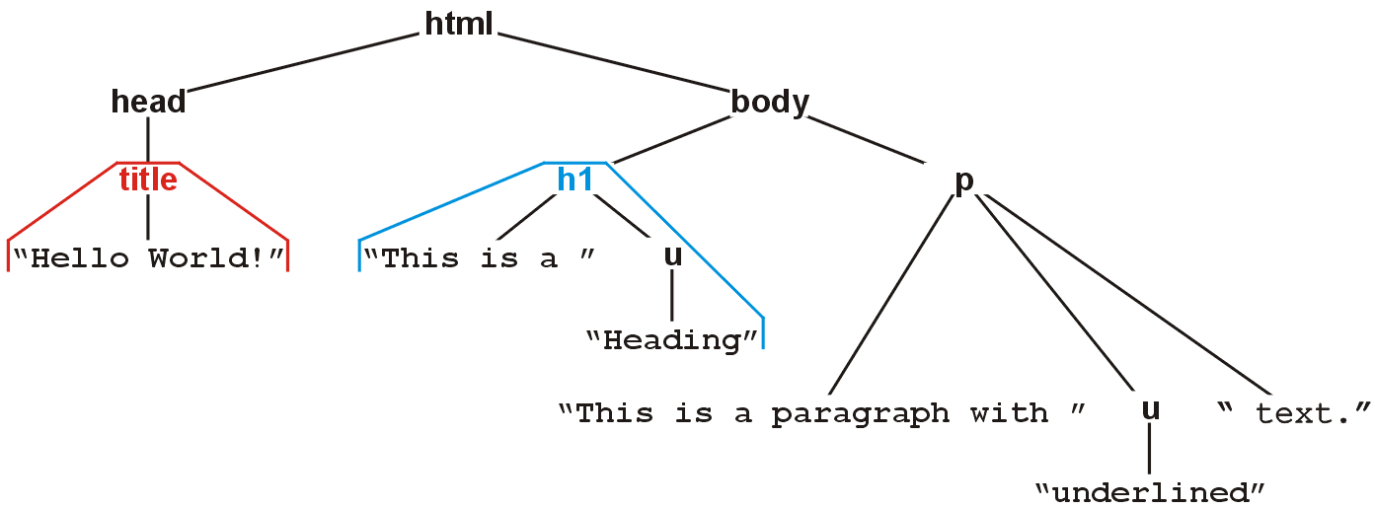
Example: XHTML and CSS
The nested tags define a tree rooted at the HTML tag
<html>
<head>
<title>Hello World!</title>
</head>
<body>
<h1>This is a <u>Heading</u></h1>
<p>This is a paragraph with some
<u>underlined</u> text.</p>
</body>
</html>

Slide 24
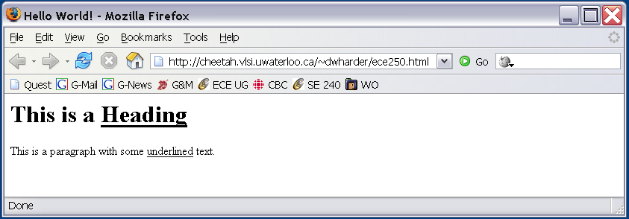
Example: XHTML and CSS
Web browsers render this tree as a web page

Slide 25
General Trees
An abstract tree does not restrict the number of nodes
In this tree, the degrees vary:
Degree | Nodes
0 | D, F, G, J, K, L, M
1 | C
2 | B, E, H
3 | I

Slide 26
Binary Tree

Slide 27
Binary Tree Definition
The arbitrary number of children in general trees is often unnecessary—many real-life trees are restricted to two branches
Expression trees using binary operators
There are also issues with general trees:
There is no natural order between a node and its children

Slide 28
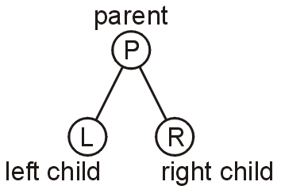
Definition
A binary tree is a restriction where each node has exactly two children:
Each child is either empty or another binary tree
This restriction allows us to label the children as left and right subtrees

Slide 29
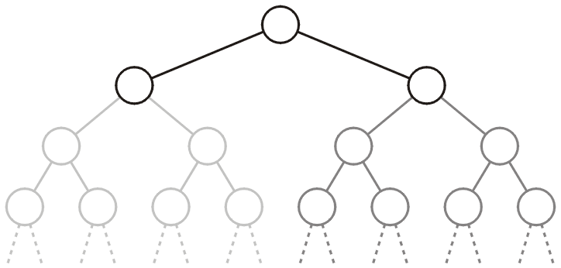
Binary Tree Definition
We will also refer to the two sub-trees as
The left-hand sub-tree, and
The right-hand sub-tree

Slide 30
Recursive definition of Binary Tree
A binary tree is
- empty OR
- a node, called the root node, together with two binary trees, which are disjoint from each other and the root node. These are called left and right subtrees of the root
Many routines can be efficiently implemented using recursive nature of the binary tree

Slide 31
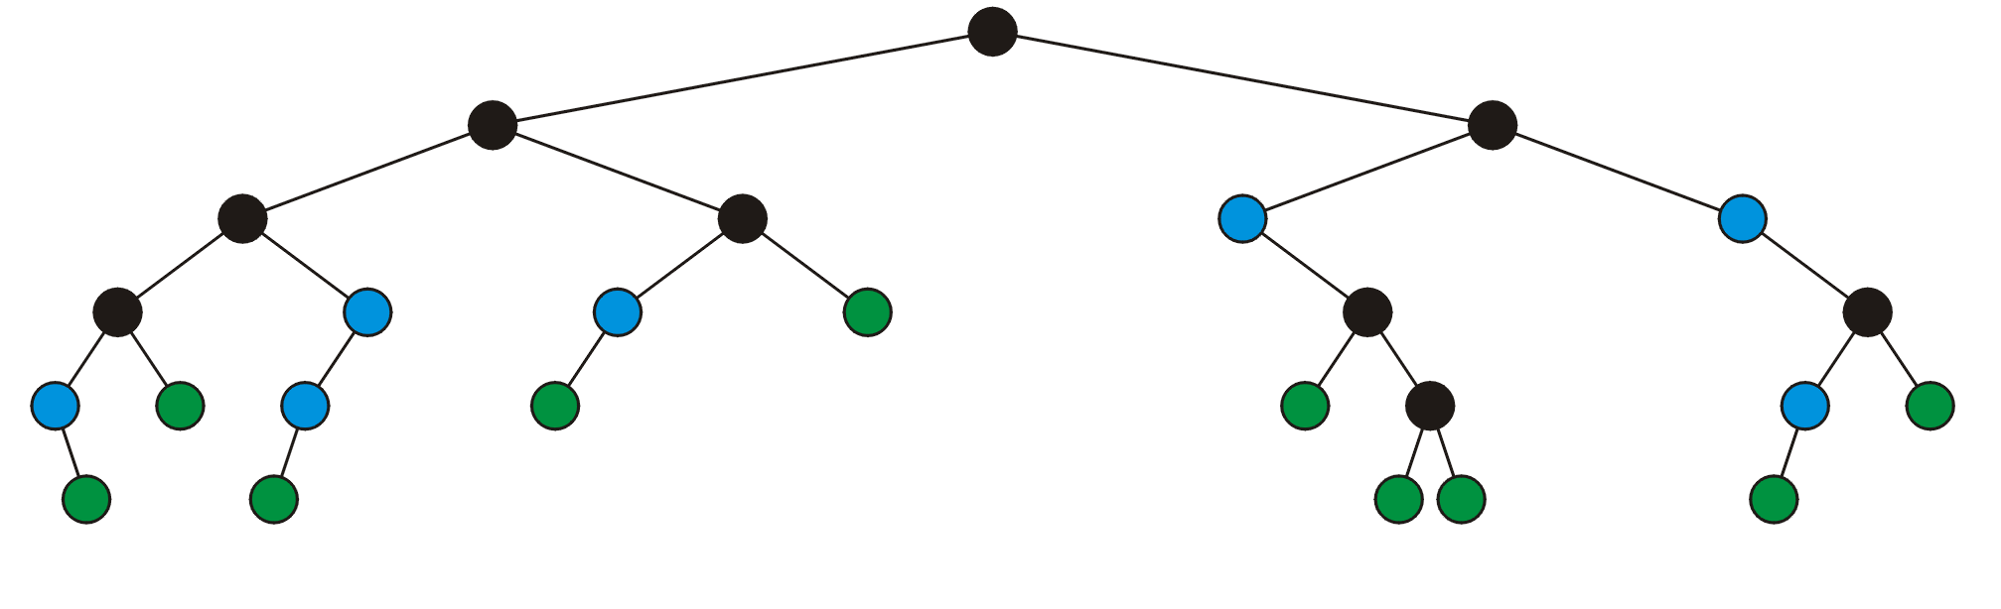
Definition
A full node is a node where both the left and right sub-trees are non-empty trees
Legend:
full nodes leaf nodes

Slide 32
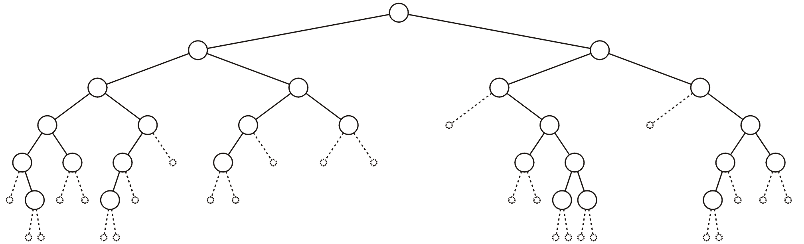
Definition
An empty node or a null sub-tree is any location where a new leaf node could be appended

Slide 33
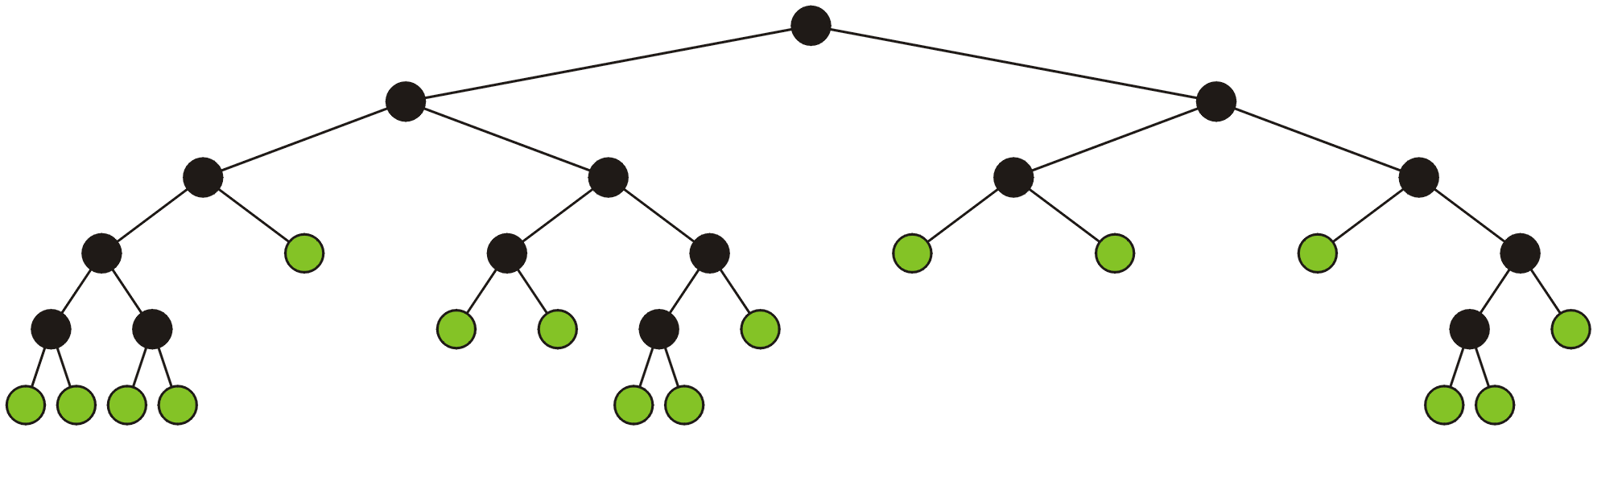
Definition: Full Binary Tree
A full binary tree is where each node is:
A full node, or
A leaf node
These have applications in
Expression trees

Slide 34
Binary Tree Applications
Expression Tree
- A central data structure in compiler design. Interior nodes contain operators and the leaf nodes have operands
- An expression is evaluated by applying the operator at root to the values obtained by recursively evaluating the left and right subtrees
- The following tree corresponds the expression: (a+((b-c)*d)
+
a
*
-
d
b
c

Slide 35
Types of Binary Tree
Full - Every node has exactly two children in all levels, except the last level. Nodes in last level have 0 children
Complete - Full up to second last level and last level is filled from left to right
Other - not full or complete

Slide 36
Full, Complete or Other?
A
not binary
B
C
D
I
H
G
F
E
J
K
L
M
N
O
T
S
R
Q
P

Slide 37
Full, Complete or Other?
A
B
D
I
H
G
F
K
L
M
N
O
P
Q
R

Slide 38
Full, Complete or Other?
A
B
D
I
H
G
F
K
L
M
N
O
P
Q
R
Full - Every node has exactly two children in all levels, except the last level.
Nodes in last level have 0 children

Slide 39
Full, Complete or Other?
A
B
D
I
H
G
F
K
L
M
N
O
P
Q
R
T
S

Slide 40
Full, Complete or Other?
A
B
D
I
H
G
F
K
L
M
N
O
P
Q
R
T
S
Complete - Full up to second last level and last level is filled from left to right

Slide 41
Full, Complete or other?
A
B
D
I
H
G
F
K
L
M
N
O
T
S
R
P

Slide 42
Full, Complete or other?
A
B
D
I
H
G
F
K
L
M
N
O
T
S
R
P
Other - not full or complete

Slide 43
Define
Processing of a Tree
Traversing of a Tree

Slide 44
Binary Tree Traversal
Process
To process a node means to perform some simple operation like printing the contents of the node or updating the contents of the node
Traversal
To traverse a finite collection of objects means to process each object in the collection exactly once
Examples
List traversal – to process each element of list exactly once
Tree traversal – to process each node of tree exactly once

Slide 45
Tree traversals
Tree traversals:
A means of visiting all the objects in a tree data structure
Breadth-first traversals
Depth-first traversals
Pre-order and Post-order depth-first traversals
Applications
General guidelines

Slide 46
Background
All the objects stored in an array or linked list can be accessed sequentially.
How we accessed objects stored in a tree.
Notes:
46

Slide 47
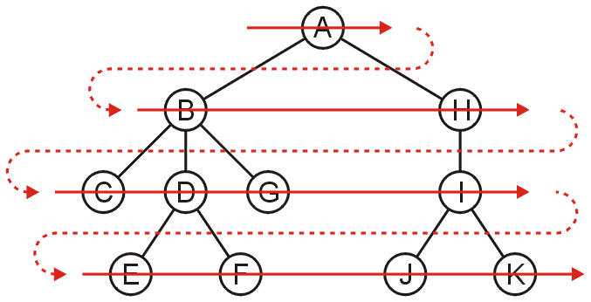
Breadth-First Traversal
Breadth-first traversals visit all nodes at a given depth
Can be implemented using a queue
Run time is Θ(n)
Order: A B H C D G I E F J K

Slide 48
Breadth-First Traversal of a Binary Tree

Slide 49
Simple Binary Tree
A
B
C
D
E
F
G
H
I
J
K
L
M
N
O

Slide 50
Breadth-First Search
A
B
C
D
E
F
G
H
I
J
K
L
M
N
O

Slide 51
Breadth-First Search
A
B
C
D
E
F
G
H
I
J
K
L
M
N
O
A

Slide 52
Breadth-First Search
A
B
C
D
E
F
G
H
I
J
K
L
M
N
O
A

Slide 53
Breadth-First Search
A
B
C
D
E
F
G
H
I
J
K
L
M
N
O
A B

Slide 54
Breadth-First Search
A
B
C
D
E
F
G
H
I
J
K
L
M
N
O
A B

Slide 55
Breadth-First Search
A
B
C
D
E
F
G
H
I
J
K
L
M
N
O
A B C

Slide 56
Breadth-First Search
A
B
C
D
E
F
G
H
I
J
K
L
M
N
O
A B C

Slide 57
Breadth-First Search
A
B
C
D
E
F
G
H
I
J
K
L
M
N
O
A B C D

Slide 58
Breadth-First Search
A
B
C
D
E
F
G
H
I
J
K
L
M
N
O
A B C D

Slide 59
Breadth-First Search
A
B
C
D
E
F
G
H
I
J
K
L
M
N
O
A B C D E

Slide 60
Breadth-First Search
A
B
C
D
E
F
G
H
I
J
K
L
M
N
O
A B C D E

Slide 61
Breadth-First Search
A
B
C
D
E
F
G
H
I
J
K
L
M
N
O
A B C D E F

Slide 62
Breadth-First Search
A
B
C
D
E
F
G
H
I
J
K
L
M
N
O
A B C D E F

Slide 63
Breadth-First Search
A
B
C
D
E
F
G
H
I
J
K
L
M
N
O
A B C D E F G

Slide 64
Breadth-First Search
A
B
C
D
E
F
G
H
I
J
K
L
M
N
O
A B C D E F G

Slide 65
Breadth-First Search
A
B
C
D
E
F
G
H
I
J
K
L
M
N
O
A B C D E F G H

Slide 66
Breadth-First Search
A
B
C
D
E
F
G
H
I
J
K
L
M
N
O
A B C D E F G H

Slide 67
Breadth-First Search
A
B
C
D
E
F
G
H
I
J
K
L
M
N
O
A B C D E F G H I

Slide 68
Breadth-First Search
A
B
C
D
E
F
G
H
I
J
K
L
M
N
O
A B C D E F G H I

Slide 69
Breadth-First Search
A
B
C
D
E
F
G
H
I
J
K
L
M
N
O
A B C D E F G H I J

Slide 70
Breadth-First Search
A
B
C
D
E
F
G
H
I
J
K
L
M
N
O
A B C D E F G H I J

Slide 71
Breadth-First Search
A
B
C
D
E
F
G
H
I
J
K
L
M
N
O
A B C D E F G H I J K

Slide 72
Breadth-First Search
A
B
C
D
E
F
G
H
I
J
K
L
M
N
O
A B C D E F G H I J K

Slide 73
Breadth-First Search
A
B
C
D
E
F
G
H
I
J
K
L
M
N
O
A B C D E F G H I J K L

Slide 74
Breadth-First Search
A
B
C
D
E
F
G
H
I
J
K
L
M
N
O
A B C D E F G H I J K L

Slide 75
Breadth-First Search
A
B
C
D
E
F
G
H
I
J
K
L
M
N
O
A B C D E F G H I J K L M

Slide 76
Breadth-First Search
A
B
C
D
E
F
G
H
I
J
K
L
M
N
O
A B C D E F G H I J K L M

Slide 77
Breadth-First Search
A
B
C
D
E
F
G
H
I
J
K
L
M
N
O
A B C D E F G H I J K L M N

Slide 78
Breadth-First Search
A
B
C
D
E
F
G
H
I
J
K
L
M
N
O
A B C D E F G H I J K L M N

Slide 79
Breadth-First Search
A
B
C
D
E
F
G
H
I
J
K
L
M
N
O
A B C D E F G H I J K L M N O

Slide 80
Breadth-First Search
A
B
C
D
E
F
G
H
I
J
K
L
M
N
O
A B C D E F G H I J K L M N O

Slide 81
Pseudo-Code for Breadth-First Traversal
breadth-first-traversal
put root node onto a queue
while the queue is not empty
dequeue the next node
visit the node e.g., print value
enqueue the left child node
enqueue the right child node

Slide 82
Breadth-First Search
put root node onto a queue
while the queue is not empty
dequeue the next node
visit the node e.g., print value
enqueue the left child node
enqueue the right child node
Queue:
A
B
C
Current:
D
E
F
G
A B C D E F G

Slide 83
Breadth-First Search
put root node onto a queue
while the queue is not empty
dequeue the next node
visit the node e.g., print value
enqueue the left child node
enqueue the right child node
Queue:
A
A
B
C
Current:
D
E
F
G

Slide 84
Breadth-First Search
put root node onto a queue
while the queue is not empty
dequeue the next node
visit the node e.g., print value
enqueue the left child node
enqueue the right child node
Queue:
A
A
B
C
Current:
D
E
F
G
A

Slide 85
Breadth-First Search
put root node onto a queue
while the queue is not empty
dequeue the next node
visit the node e.g., print value
enqueue the left child node
enqueue the right child node
Queue:
A
B
C
Current:
D
E
F
G
A
A

Slide 86
Breadth-First Search
put root node onto a queue
while the queue is not empty
dequeue the next node
visit the node e.g., print value
enqueue the left child node
enqueue the right child node
Queue:
A
B
B
C
Current:
D
E
F
G
A
A

Slide 87
Breadth-First Search
put root node onto a queue
while the queue is not empty
dequeue the next node
visit the node e.g., print value
enqueue the left child node
enqueue the right child node
Queue:
A
C
B
B
C
Current:
D
E
F
G
A
A

Slide 88
Breadth-First Search
put root node onto a queue
while the queue is not empty
dequeue the next node
visit the node e.g., print value
enqueue the left child node
enqueue the right child node
Queue:
A
C
B
B
C
Current:
D
E
F
G
B
A

Slide 89
Breadth-First Search
put root node onto a queue
while the queue is not empty
dequeue the next node
visit the node e.g., print value
enqueue the left child node
enqueue the right child node
Queue:
A
C
B
C
Current:
D
E
F
G
B
A B

Slide 90
Breadth-First Search
put root node onto a queue
while the queue is not empty
dequeue the next node
visit the node e.g., print value
enqueue the left child node
enqueue the right child node
Queue:
A
D
C
B
C
Current:
D
E
F
G
B
A B

Slide 91
Breadth-First Search
put root node onto a queue
while the queue is not empty
dequeue the next node
visit the node e.g., print value
enqueue the left child node
enqueue the right child node
Queue:
A
E
D
C
B
C
Current:
D
E
F
G
B
A B

Slide 92
Breadth-First Search
put root node onto a queue
while the queue is not empty
dequeue the next node
visit the node e.g., print value
enqueue the left child node
enqueue the right child node
Queue:
A
E
D
C
B
C
Current:
D
E
F
G
C
A B

Slide 93
Breadth-First Search
put root node onto a queue
while the queue is not empty
dequeue the next node
visit the node e.g., print value
enqueue the left child node
enqueue the right child node
Queue:
A
E
D
B
C
Current:
D
E
F
G
C
A B C

Slide 94
Breadth-First Search
put root node onto a queue
while the queue is not empty
dequeue the next node
visit the node e.g., print value
enqueue the left child node
enqueue the right child node
Queue:
A
F
E
D
B
C
Current:
D
E
F
G
C
A B C

Slide 95
Breadth-First Search
put root node onto a queue
while the queue is not empty
dequeue the next node
visit the node e.g., print value
enqueue the left child node
enqueue the right child node
Queue:
A
G
F
E
D
B
C
D
E
F
G
Current:
C
A B C

Slide 96
Breadth-First Search
put root node onto a queue
while the queue is not empty
dequeue the next node
visit the node e.g., print value
enqueue the left child node
enqueue the right child node
Queue:
A
G
F
E
D
B
C
D
E
F
G
Current:
D
A B C

Slide 97
Breadth-First Search
put root node onto a queue
while the queue is not empty
dequeue the next node
visit the node e.g., print value
enqueue the left child node
enqueue the right child node
Queue:
A
G
F
E
B
C
D
E
F
G
Current:
D
A B C D

Slide 98
Breadth-First Search
put root node onto a queue
while the queue is not empty
dequeue the next node
visit the node e.g., print value
enqueue the left child node
enqueue the right child node
Queue:
A
G
F
E
B
C
D
E
F
G
Current:
E
A B C D

Slide 99
Breadth-First Search
put root node onto a queue
while the queue is not empty
dequeue the next node
visit the node e.g., print value
enqueue the left child node
enqueue the right child node
Queue:
A
G
F
B
C
D
E
F
G
Current:
E
A B C D E

Slide 100
Breadth-First Search
put root node onto a queue
while the queue is not empty
dequeue the next node
visit the node e.g., print value
enqueue the left child node
enqueue the right child node
Queue:
A
G
F
B
C
D
E
F
G
Current:
F
A B C D E

Slide 101
Breadth-First Search
put root node onto a queue
while the queue is not empty
dequeue the next node
visit the node e.g., print value
enqueue the left child node
enqueue the right child node
Queue:
A
G
B
C
D
E
F
G
Current:
F
A B C D E F

Slide 102
Breadth-First Search
put root node onto a queue
while the queue is not empty
dequeue the next node
visit the node e.g., print value
enqueue the left child node
enqueue the right child node
Queue:
A
G
B
C
D
E
F
G
Current:
G
A B C D E F

Slide 103
Breadth-First Search
put root node onto a queue
while the queue is not empty
dequeue the next node
visit the node e.g., print value
enqueue the left child node
enqueue the right child node
Queue:
A
B
C
D
E
F
G
Current:
G
A B C D E F G

Slide 104
Breadth-First Search
put root node onto a queue
while the queue is not empty
dequeue the next node
visit the node e.g., print value
enqueue the left child node
enqueue the right child node
A
B
C
D
E
F
G
A B C D E F G

Slide 105
Time and Space Complexity for Breadth-First Search Alg.
Time Complexity
Consider each node twice O(n)
when put on queue
when taken from queue

Slide 106
Time and Space Complexity for Breadth-First Search Alg.
Space Complexity
Queue to handle unexplored nodes
Queue length = width of lowest level
O(n)

Slide 107
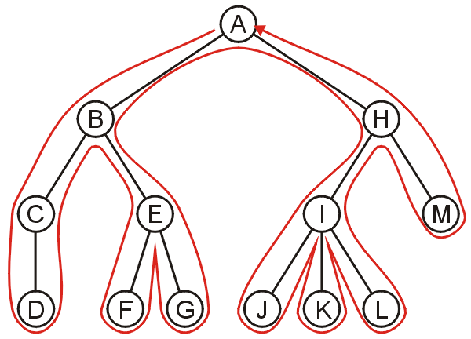
Backtracking
To discuss depth-first traversals, we will define a backtracking algorithm for stepping through a tree:
At any node, we proceed to the first child that has not yet been visited
Or, if we have visited all the children (of which a leaf node is a special case), we backtrack to the parent and repeat this decision making process
We end once all the children of the root are visited

Slide 108
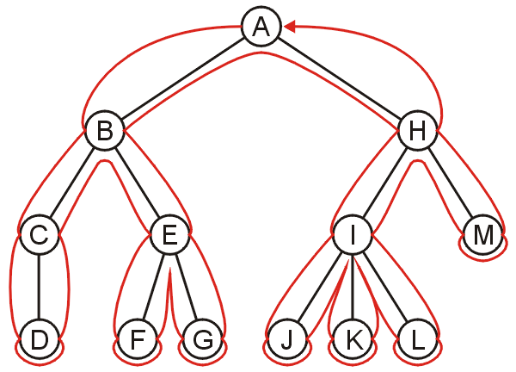
Depth-first Traversal
We define such a path as a depth-first traversal
We note that each node could be visited twice in such a scheme
The first time the node is approached (before any children)
The last time it is approached (after all children)

Slide 109
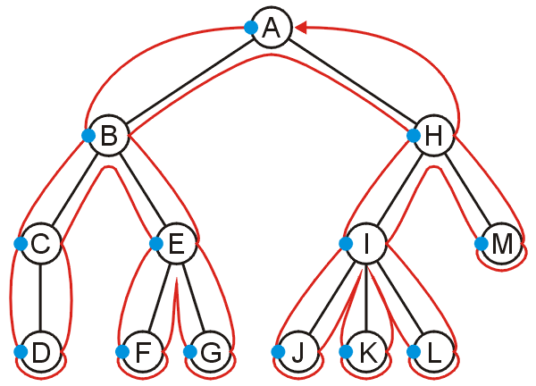
Pre-order Depth-first Traversal
Visiting each node first results in the sequence
A, B, C, D, E, F, G, H, I, J, K, L, M

Slide 110
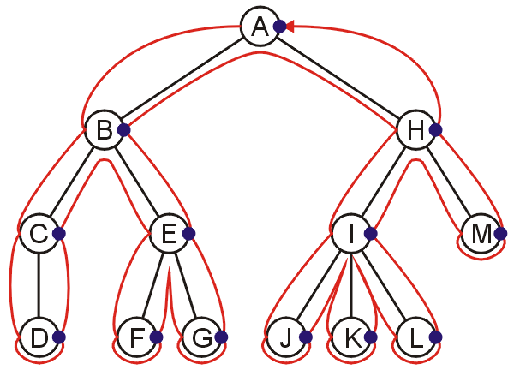
Post-order Depth-first Traversal
Visiting the nodes with their last visit:
D, C, F, G, E, B, J, K, L, I, M, H, A

Slide 111
Traversal Of Binary Tree
There are four methods for the traversal of a binary tree
Preorder Traversal :Each node is processed before any node in either of its subtrees
Inorder Traversal: Each node is processed after all nodes in its left subtree and before any node in its right subtree
Postorder Traversal: Each node is processed after all nodes in both of its subtrees
Level order Traversal: Each node at level l is processed before any node at level l+1

Slide 112
Depth-First Search
Pre-order Traversal:
Root - Left Child - Right Child

Slide 113
Preorder Traversals
Visit the root
Visit Left subtree
Visit Right subtree
A
1
Each node is processed before any node in either of its subtrees
B
D
2
11
I
H
G
F
3
8
12
13
O
K
L
M
N
14
4
5
9
10
T
S
R
P
6
7
15
16

Slide 114
Preorder Traversals
Algorithm TraversePreorder(n)
Process node n
if n is an internal node then
TraversePreorder( n -> leftChild)
TraversePreorder( n -> rightChild)

Slide 115
Pre-order Traversal: Root - Left Child - Right Child
A
B
C
D
E
F
G
H
I
J
K
L
M
N
O

Slide 116
Pre-order Traversal: Root - Left Child - Right Child
A
B
C
D
E
F
G
H
I
J
K
L
M
N
O
A

Slide 117
Pre-order Traversal: Root - Left Child - Right Child
A
B
C
D
E
F
G
H
I
J
K
L
M
N
O
A

Slide 118
Pre-order Traversal: Root - Left Child - Right Child
A
B
C
D
E
F
G
H
I
J
K
L
M
N
O
A B

Slide 119
Pre-order Traversal: Root - Left Child - Right Child
A
B
C
D
E
F
G
H
I
J
K
L
M
N
O
A B

Slide 120
Pre-order Traversal: Root - Left Child - Right Child
A
B
C
D
E
F
G
H
I
J
K
L
M
N
O
A B D

Slide 121
Pre-order Traversal: Root - Left Child - Right Child
A
B
C
D
E
F
G
H
I
J
K
L
M
N
O
A B D

Slide 122
Pre-order Traversal: Root - Left Child - Right Child
A
B
C
D
E
F
G
H
I
J
K
L
M
N
O
A B D H

Slide 123
Pre-order Traversal: Root - Left Child - Right Child
A
B
C
D
E
F
G
H
I
J
K
L
M
N
O
A B D H

Slide 124
Pre-order Traversal: Root - Left Child - Right Child
A
B
C
D
E
F
G
H
I
J
K
L
M
N
O
A B D H

Slide 125
Pre-order Traversal: Root - Left Child - Right Child
A
B
C
D
E
F
G
H
I
J
K
L
M
N
O
A B D H I

Slide 126
Pre-order Traversal: Root - Left Child - Right Child
A
B
C
D
E
F
G
H
I
J
K
L
M
N
O
A B D H I

Slide 127
Pre-order Traversal: Root - Left Child - Right Child
A
B
C
D
E
F
G
H
I
J
K
L
M
N
O
A B D H I

Slide 128
Pre-order Traversal: Root - Left Child - Right Child
A
B
C
D
E
F
G
H
I
J
K
L
M
N
O
A B D H I

Slide 129
Pre-order Traversal: Root - Left Child - Right Child
A
B
C
D
E
F
G
H
I
J
K
L
M
N
O
A B D H I E

Slide 130
Pre-order Traversal: Root - Left Child - Right Child
A
B
C
D
E
F
G
H
I
J
K
L
M
N
O
A B D H I E

Slide 131
Pre-order Traversal: Root - Left Child - Right Child
A
B
C
D
E
F
G
H
I
J
K
L
M
N
O
A B D H I E J

Slide 132
Pre-order Traversal: Root - Left Child - Right Child
A
B
C
D
E
F
G
H
I
J
K
L
M
N
O
A B D H I E J

Slide 133
Pre-order Traversal: Root - Left Child - Right Child
A
B
C
D
E
F
G
H
I
J
K
L
M
N
O
A B D H I E J

Slide 134
Pre-order Traversal: Root - Left Child - Right Child
A
B
C
D
E
F
G
H
I
J
K
L
M
N
O
A B D H I E J K

Slide 135
Pre-order Traversal: Root - Left Child - Right Child
A
B
C
D
E
F
G
H
I
J
K
L
M
N
O
A B D H I E J K

Slide 136
Pre-order Traversal: Root - Left Child - Right Child
A
B
C
D
E
F
G
H
I
J
K
L
M
N
O
A B D H I E J K

Slide 137
Pre-order Traversal: Root - Left Child - Right Child
A
B
C
D
E
F
G
H
I
J
K
L
M
N
O
A B D H I E J K

Slide 138
Pre-order Traversal: Root - Left Child - Right Child
A
B
C
D
E
F
G
H
I
J
K
L
M
N
O
A B D H I E J K

Slide 139
Pre-order Traversal: Root - Left Child - Right Child
A
B
C
D
E
F
G
H
I
J
K
L
M
N
O
A B D H I E J K C

Slide 140
Pre-order Traversal: Root - Left Child - Right Child
A
B
C
D
E
F
G
H
I
J
K
L
M
N
O
A B D H I E J K C

Slide 141
Pre-order Traversal: Root - Left Child - Right Child
A
B
C
D
E
F
G
H
I
J
K
L
M
N
O
A B D H I E J K C F

Slide 142
Pre-order Traversal: Root - Left Child - Right Child
A
B
C
D
E
F
G
H
I
J
K
L
M
N
O
A B D H I E J K C F

Slide 143
Pre-order Traversal: Root - Left Child - Right Child
A
B
C
D
E
F
G
H
I
J
K
L
M
N
O
A B D H I E J K C F L

Slide 144
Pre-order Traversal: Root - Left Child - Right Child
A
B
C
D
E
F
G
H
I
J
K
L
M
N
O
A B D H I E J K C F L

Slide 145
Pre-order Traversal: Root - Left Child - Right Child
A
B
C
D
E
F
G
H
I
J
K
L
M
N
O
A B D H I E J K C F L

Slide 146
Pre-order Traversal: Root - Left Child - Right Child
A
B
C
D
E
F
G
H
I
J
K
L
M
N
O
A B D H I E J K C F L M

Slide 147
Pre-order Traversal: Root - Left Child - Right Child
A
B
C
D
E
F
G
H
I
J
K
L
M
N
O
A B D H I E J K C F L M

Slide 148
Pre-order Traversal: Root - Left Child - Right Child
A
B
C
D
E
F
G
H
I
J
K
L
M
N
O
A B D H I E J K C F L M

Slide 149
Pre-order Traversal: Root - Left Child - Right Child
A
B
C
D
E
F
G
H
I
J
K
L
M
N
O
A B D H I E J K C F L M

Slide 150
Pre-order Traversal: Root - Left Child - Right Child
A
B
C
D
E
F
G
H
I
J
K
L
M
N
O
A B D H I E J K C F L M G

Slide 151
Pre-order Traversal: Root - Left Child - Right Child
A
B
C
D
E
F
G
H
I
J
K
L
M
N
O
A B D H I E J K C F L M G

Slide 152
Pre-order Traversal: Root - Left Child - Right Child
A
B
C
D
E
F
G
H
I
J
K
L
M
N
O
A B D H I E J K C F L M G N

Slide 153
Pre-order Traversal: Root - Left Child - Right Child
A
B
C
D
E
F
G
H
I
J
K
L
M
N
O
A B D H I E J K C F L M G N

Slide 154
Pre-order Traversal: Root - Left Child - Right Child
A
B
C
D
E
F
G
H
I
J
K
L
M
N
O
A B D H I E J K C F L M G N

Slide 155
Pre-order Traversal: Root - Left Child - Right Child
A
B
C
D
E
F
G
H
I
J
K
L
M
N
O
A B D H I E J K C F L M G N O

Slide 156
Pre-order Traversal: Root - Left Child - Right Child
A
B
C
D
E
F
G
H
I
J
K
L
M
N
O
A B D H I E J K C F L M G N O

Slide 157
Pre-order Traversal: Root - Left Child - Right Child
A
B
C
D
E
F
G
H
I
J
K
L
M
N
O
A B D H I E J K C F L M G N O

Slide 158
Pre-order Traversal: Root - Left Child - Right Child
A
B
C
D
E
F
G
H
I
J
K
L
M
N
O
A B D H I E J K C F L M G N O

Slide 159
Pre-order Traversal: Root - Left Child - Right Child
A
B
C
D
E
F
G
H
I
J
K
L
M
N
O
A B D H I E J K C F L M G N O

Slide 160
Pseudo-Code for Pre-order Traversal
pre-traverse
visit current node e.g., print value
pre-traverse left subtree
pre-traverse right subtree

Slide 161
Inorder Traversals
Visit Left subtree
Visit the root
Visit Right subtree
A
10
1
B
D
1
6
12
I
H
G
F
1
8
11
16
2
O
K
L
M
N
14
1
4
7
9
T
S
R
P
3
5
13
15

Slide 162
Algorithm TraverseInorder(n)
if n is an internal node then
TraverseInorder( n -> leftChild)
Process node n
if n is an internal node then
TraverseInorder( n -> rightChild)

Slide 163
In-order Traversal: Left Child - Root - Right Child
A
B
C
D
E
F
G
H
I
J
K
L
M
N
O

Slide 164
In-order Traversal: Left Child - Root - Right Child
A
B
C
D
E
F
G
H
I
J
K
L
M
N
O

Slide 165
In-order Traversal: Left Child - Root - Right Child
A
B
C
D
E
F
G
H
I
J
K
L
M
N
O

Slide 166
In-order Traversal: Left Child - Root - Right Child
A
B
C
D
E
F
G
H
I
J
K
L
M
N
O
H

Slide 167
In-order Traversal: Left Child - Root - Right Child
A
B
C
D
E
F
G
H
I
J
K
L
M
N
O
H

Slide 168
In-order Traversal: Left Child - Root - Right Child
A
B
C
D
E
F
G
H
I
J
K
L
M
N
O
H D

Slide 169
In-order Traversal: Left Child - Root - Right Child
A
B
C
D
E
F
G
H
I
J
K
L
M
N
O
H D

Slide 170
In-order Traversal: Left Child - Root - Right Child
A
B
C
D
E
F
G
H
I
J
K
L
M
N
O
H D I

Slide 171
In-order Traversal: Left Child - Root - Right Child
A
B
C
D
E
F
G
H
I
J
K
L
M
N
O
H D I

Slide 172
In-order Traversal: Left Child - Root - Right Child
A
B
C
D
E
F
G
H
I
J
K
L
M
N
O
H D I

Slide 173
In-order Traversal: Left Child - Root - Right Child
A
B
C
D
E
F
G
H
I
J
K
L
M
N
O
H D I B

Slide 174
In-order Traversal: Left Child - Root - Right Child
A
B
C
D
E
F
G
H
I
J
K
L
M
N
O
H D I B

Slide 175
In-order Traversal: Left Child - Root - Right Child
A
B
C
D
E
F
G
H
I
J
K
L
M
N
O
H D I B

Slide 176
In-order Traversal: Left Child - Root - Right Child
A
B
C
D
E
F
G
H
I
J
K
L
M
N
O
H D I B J

Slide 177
In-order Traversal: Left Child - Root - Right Child
A
B
C
D
E
F
G
H
I
J
K
L
M
N
O
H D I B J

Slide 178
In-order Traversal: Left Child - Root - Right Child
A
B
C
D
E
F
G
H
I
J
K
L
M
N
O
H D I B J E

Slide 179
In-order Traversal: Left Child - Root - Right Child
A
B
C
D
E
F
G
H
I
J
K
L
M
N
O
H D I B J E

Slide 180
In-order Traversal: Left Child - Root - Right Child
A
B
C
D
E
F
G
H
I
J
K
L
M
N
O
H D I B J E K

Slide 181
In-order Traversal: Left Child - Root - Right Child
A
B
C
D
E
F
G
H
I
J
K
L
M
N
O
H D I B J E K

Slide 182
In-order Traversal: Left Child - Root - Right Child
A
B
C
D
E
F
G
H
I
J
K
L
M
N
O
H D I B J E K

Slide 183
In-order Traversal: Left Child - Root - Right Child
A
B
C
D
E
F
G
H
I
J
K
L
M
N
O
H D I B J E K

Slide 184
In-order Traversal: Left Child - Root - Right Child
A
B
C
D
E
F
G
H
I
J
K
L
M
N
O
H D I B J E K A

Slide 185
In-order Traversal: Left Child - Root - Right Child
A
B
C
D
E
F
G
H
I
J
K
L
M
N
O
H D I B J E K A

Slide 186
In-order Traversal: Left Child - Root - Right Child
A
B
C
D
E
F
G
H
I
J
K
L
M
N
O
H D I B J E K A

Slide 187
In-order Traversal: Left Child - Root - Right Child
A
B
C
D
E
F
G
H
I
J
K
L
M
N
O
H D I B J E K A

Slide 188
In-order Traversal: Left Child - Root - Right Child
A
B
C
D
E
F
G
H
I
J
K
L
M
N
O
H D I B J E K A L

Slide 189
In-order Traversal: Left Child - Root - Right Child
A
B
C
D
E
F
G
H
I
J
K
L
M
N
O
H D I B J E K A L

Slide 190
In-order Traversal: Left Child - Root - Right Child
A
B
C
D
E
F
G
H
I
J
K
L
M
N
O
H D I B J E K A L F

Slide 191
In-order Traversal: Left Child - Root - Right Child
A
B
C
D
E
F
G
H
I
J
K
L
M
N
O
H D I B J E K A L F

Slide 192
In-order Traversal: Left Child - Root - Right Child
A
B
C
D
E
F
G
H
I
J
K
L
M
N
O
H D I B J E K A L F M

Slide 193
In-order Traversal: Left Child - Root - Right Child
A
B
C
D
E
F
G
H
I
J
K
L
M
N
O
H D I B J E K A L F M

Slide 194
In-order Traversal: Left Child - Root - Right Child
A
B
C
D
E
F
G
H
I
J
K
L
M
N
O
H D I B J E K A L F M

Slide 195
In-order Traversal: Left Child - Root - Right Child
A
B
C
D
E
F
G
H
I
J
K
L
M
N
O
H D I B J E K A L F M C

Slide 196
In-order Traversal: Left Child - Root - Right Child
A
B
C
D
E
F
G
H
I
J
K
L
M
N
O
H D I B J E K A L F M C

Slide 197
In-order Traversal: Left Child - Root - Right Child
A
B
C
D
E
F
G
H
I
J
K
L
M
N
O
H D I B J E K A L F M C

Slide 198
In-order Traversal: Left Child - Root - Right Child
A
B
C
D
E
F
G
H
I
J
K
L
M
N
O
H D I B J E K A L F M C N

Slide 199
In-order Traversal: Left Child - Root - Right Child
A
B
C
D
E
F
G
H
I
J
K
L
M
N
O
H D I B J E K A L F M C N

Slide 200
In-order Traversal: Left Child - Root - Right Child
A
B
C
D
E
F
G
H
I
J
K
L
M
N
O
H D I B J E K A L F M C N G

Slide 201
In-order Traversal: Left Child - Root - Right Child
A
B
C
D
E
F
G
H
I
J
K
L
M
N
O
H D I B J E K A L F M C N G

Slide 202
In-order Traversal: Left Child - Root - Right Child
A
B
C
D
E
F
G
H
I
J
K
L
M
N
O
H D I B J E K A L F M C N G O

Slide 203
In-order Traversal: Left Child - Root - Right Child
A
B
C
D
E
F
G
H
I
J
K
L
M
N
O
H D I B J E K A L F M C N G O

Slide 204
In-order Traversal: Left Child - Root - Right Child
A
B
C
D
E
F
G
H
I
J
K
L
M
N
O
H D I B J E K A L F M C N G O

Slide 205
In-order Traversal: Left Child - Root - Right Child
A
B
C
D
E
F
G
H
I
J
K
L
M
N
O
H D I B J E K A L F M C N G O

Slide 206
In-order Traversal: Left Child - Root - Right Child
A
B
C
D
E
F
G
H
I
J
K
L
M
N
O
H D I B J E K A L F M C N G O

Slide 207
Pseudo-Code for In-order Traversal
in-traverse
in-traverse left subtree
visit current node e.g., print value
in-traverse right subtree

Slide 208
Postorder Traversals
Visit Left subtree
Visit Right subtree
Visit the root
A
16
B
D
9
15
I
H
G
F
2
8
10
14
5
O
K
L
M
N
13
1
4
2
3
6
7
T
S
R
P
2
3
11
12

Slide 209
Algorithm TraversePostorder(n)
if n is an internal node then
TraversePostorder( n -> leftChild)
TraversePostorder( n -> rightChild)
Process node n

Slide 210
Post-order Traversal: Left Child - Right Child - Root
A
B
C
D
E
F
G
H
I
J
K
L
M
N
O

Slide 211
Post-order Traversal: Left Child - Right Child - Root
A
B
C
D
E
F
G
H
I
J
K
L
M
N
O

Slide 212
Post-order Traversal: Left Child - Right Child - Root
A
B
C
D
E
F
G
H
I
J
K
L
M
N
O

Slide 213
Post-order Traversal: Left Child - Right Child - Root
A
B
C
D
E
F
G
H
I
J
K
L
M
N
O
H

Slide 214
Post-order Traversal: Left Child - Right Child - Root
A
B
C
D
E
F
G
H
I
J
K
L
M
N
O
H

Slide 215
Post-order Traversal: Left Child - Right Child - Root
A
B
C
D
E
F
G
H
I
J
K
L
M
N
O
H

Slide 216
Post-order Traversal: Left Child - Right Child - Root
A
B
C
D
E
F
G
H
I
J
K
L
M
N
O
H I

Slide 217
Post-order Traversal: Left Child - Right Child - Root
A
B
C
D
E
F
G
H
I
J
K
L
M
N
O
H I

Slide 218
Post-order Traversal: Left Child - Right Child - Root
A
B
C
D
E
F
G
H
I
J
K
L
M
N
O
H I D

Slide 219
Post-order Traversal: Left Child - Right Child - Root
A
B
C
D
E
F
G
H
I
J
K
L
M
N
O
H I D

Slide 220
Post-order Traversal: Left Child - Right Child - Root
A
B
C
D
E
F
G
H
I
J
K
L
M
N
O
H I D

Slide 221
Post-order Traversal: Left Child - Right Child - Root
A
B
C
D
E
F
G
H
I
J
K
L
M
N
O
H I D

Slide 222
Post-order Traversal: Left Child - Right Child - Root
A
B
C
D
E
F
G
H
I
J
K
L
M
N
O
H I D J

Slide 223
Post-order Traversal: Left Child - Right Child - Root
A
B
C
D
E
F
G
H
I
J
K
L
M
N
O
H I D J

Slide 224
Post-order Traversal: Left Child - Right Child - Root
A
B
C
D
E
F
G
H
I
J
K
L
M
N
O
H I D J

Slide 225
Post-order Traversal: Left Child - Right Child - Root
A
B
C
D
E
F
G
H
I
J
K
L
M
N
O
H I D J K

Slide 226
Post-order Traversal: Left Child - Right Child - Root
A
B
C
D
E
F
G
H
I
J
K
L
M
N
O
H I D J K

Slide 227
Post-order Traversal: Left Child - Right Child - Root
A
B
C
D
E
F
G
H
I
J
K
L
M
N
O
H I D J K E

Slide 228
Post-order Traversal: Left Child - Right Child - Root
A
B
C
D
E
F
G
H
I
J
K
L
M
N
O
H I D J K E

Slide 229
Post-order Traversal: Left Child - Right Child - Root
A
B
C
D
E
F
G
H
I
J
K
L
M
N
O
H I D J K E B

Slide 230
Post-order Traversal: Left Child - Right Child - Root
A
B
C
D
E
F
G
H
I
J
K
L
M
N
O
H I D J K E B

Slide 231
Post-order Traversal: Left Child - Right Child - Root
A
B
C
D
E
F
G
H
I
J
K
L
M
N
O
H I D J K E B

Slide 232
Post-order Traversal: Left Child - Right Child - Root
A
B
C
D
E
F
G
H
I
J
K
L
M
N
O
H I D J K E B

Slide 233
Post-order Traversal: Left Child - Right Child - Root
A
B
C
D
E
F
G
H
I
J
K
L
M
N
O
H I D J K E B

Slide 234
Post-order Traversal: Left Child - Right Child - Root
A
B
C
D
E
F
G
H
I
J
K
L
M
N
O
H I D J K E B L

Slide 235
Post-order Traversal: Left Child - Right Child - Root
A
B
C
D
E
F
G
H
I
J
K
L
M
N
O
H I D J K E B L

Slide 236
Post-order Traversal: Left Child - Right Child - Root
A
B
C
D
E
F
G
H
I
J
K
L
M
N
O
H I D J K E B L

Slide 237
Post-order Traversal: Left Child - Right Child - Root
A
B
C
D
E
F
G
H
I
J
K
L
M
N
O
H I D J K E B L M

Slide 238
Post-order Traversal: Left Child - Right Child - Root
A
B
C
D
E
F
G
H
I
J
K
L
M
N
O
H I D J K E B L M

Slide 239
Post-order Traversal: Left Child - Right Child - Root
A
B
C
D
E
F
G
H
I
J
K
L
M
N
O
H I D J K E B L M F

Slide 240
Post-order Traversal: Left Child - Right Child - Root
A
B
C
D
E
F
G
H
I
J
K
L
M
N
O
H I D J K E B L M F

Slide 241
Post-order Traversal: Left Child - Right Child - Root
A
B
C
D
E
F
G
H
I
J
K
L
M
N
O
H I D J K E B L M F

Slide 242
Post-order Traversal: Left Child - Right Child - Root
A
B
C
D
E
F
G
H
I
J
K
L
M
N
O
H I D J K E B L M F

Slide 243
Post-order Traversal: Left Child - Right Child - Root
A
B
C
D
E
F
G
H
I
J
K
L
M
N
O
H I D J K E B L M F N

Slide 244
Post-order Traversal: Left Child - Right Child - Root
A
B
C
D
E
F
G
H
I
J
K
L
M
N
O
H I D J K E B L M F N

Slide 245
Post-order Traversal: Left Child - Right Child - Root
A
B
C
D
E
F
G
H
I
J
K
L
M
N
O
H I D J K E B L M F N

Slide 246
Post-order Traversal: Left Child - Right Child - Root
A
B
C
D
E
F
G
H
I
J
K
L
M
N
O
H I D J K E B L M F N O

Slide 247
Post-order Traversal: Left Child - Right Child - Root
A
B
C
D
E
F
G
H
I
J
K
L
M
N
O
H I D J K E B L M F N O

Slide 248
Post-order Traversal: Left Child - Right Child - Root
A
B
C
D
E
F
G
H
I
J
K
L
M
N
O
H I D J K E B L M F N O G

Slide 249
Post-order Traversal: Left Child - Right Child - Root
A
B
C
D
E
F
G
H
I
J
K
L
M
N
O
H I D J K E B L M F N O G

Slide 250
Post-order Traversal: Left Child - Right Child - Root
A
B
C
D
E
F
G
H
I
J
K
L
M
N
O
H I D J K E B L M F N O G C

Slide 251
Post-order Traversal: Left Child - Right Child - Root
A
B
C
D
E
F
G
H
I
J
K
L
M
N
O
H I D J K E B L M F N O G C

Slide 252
Post-order Traversal: Left Child - Right Child - Root
A
B
C
D
E
F
G
H
I
J
K
L
M
N
O
H I D J K E B L M F N O G C A

Slide 253
Post-order Traversal: Left Child - Right Child - Root
A
B
C
D
E
F
G
H
I
J
K
L
M
N
O
H I D J K E B L M F N O G C A

Slide 254
Pseudo-Code for Post-order Traversal
post-traverse
post-traverse left subtree
post-traverse right subtree
visit current node e.g., print value

Slide 255
Postorder Traversals
Visit Left subtree
Visit Right subtree
Visit the root
A
16
B
D
9
15
I
H
G
F
2
8
10
14
5
O
K
L
M
N
13
1
4
2
3
6
7
T
S
R
P
2
3
11
12

Slide 256
Time and Space Complexity for Depth-First Search Algs.
Time Complexity
Visit each node three times O(n)
first arrival
return from left child
return from right child

Slide 257
Time and Space Complexity for Depth-First Search Algs.
Space Complexity
Stack to handle recursion
Stack length = depth of tree
best case: lg n
worst case: n O(n)

Slide 258
Level Order Traversals
A
Visit the root
Visit root of Left subtree
Visit root of Right subtree
???
1
B
D
2
3
B
I
H
G
F
4
5
6
7
8
H
O
9
K
L
M
N
14
10
11
12
13
T
S
R
P
17
18
19
20
M
N
15
16

Slide 259
Tree ADT
Objects: any type of objects can be stored in a tree
Methods:
accessor methods
root() – return the root of the tree
parent(p) – return the parent of a node
children(p) – returns the children of a node
query methods
size() – returns the number of nodes in the tree
isEmpty() - returns true if the tree is empty
elements() – returns all elements
isRoot(p), isInternal(p), isExternal(p)

Slide 260
Guidelines
Depth-first traversals are used whenever:
The parent needs information about all its children or descendants, or
The children require information about all its parent or ancestors

Slide 261
Implementing Depth-First Traversals
we can use a stack:
Create a stack and push the root node onto the stack
While the stack is not empty:
Pop the top node
Push all of the children of that node to the top of the stack in reverse order
Run time is Θ(n)
The objects on the stack are all unvisited siblings from the root to the current node
If each node has a maximum of two children, the memory required is Θ(h): the height of the tree
With the recursive implementation, the memory is Θ(h): recursion just hides the memory
Notes:
261

Slide 262
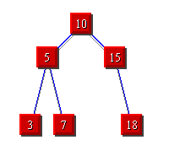






DEMO: Stack Based Depth First Traversal
The only difference between Breadth First Search (Queue) and Depth First Search (Stack) is the Data Structure!
Add the root node to the stack.
Continue until the stack is empty.
Pop a node from the top of the stack.
Visit it.
Push its children

Slide 263
Applications
Tree application: displaying information about directory structures and the files contained within
Finding the height of a tree
Printing a hierarchical structure
Determining memory usage

Slide 264
Tree Vs Graph

Slide 265
Tree Vs Graph
A tree is a connected graph
There is a path to every node in the tree
There are no cycles in the tree.

Slide 266
Is it a Tree?

Slide 267
Is it a Tree?
NO!
All the nodes are not connected
yes!
yes! (but not a binary tree)
NO!
There is a cycle and an extra edge (5 nodes and 5 edges)
yes! (it’s actually the same graph as the blue one) – but usually we draw tree by its “levels”

Slide 268
Relationship Between
No of Nodes and No of edges

Slide 269
Relationship Between
No of Nodes and No of edges
Number of edges in a tree is one less than the number of nodes. (Prove ? Assignment)

Slide 270
Representation of a Binary Tree
Representation of a binary tree is very much like linked list.
Each node has two references one to the right child and one to the left child.
item
leftChild
rightChild
TreeNode
A
B
C
D

Slide 271
Measuring a Tree
Calculate Height
Calculate No of Nodes
Calculate No of Leave Nodes
A
B
C
D
E
F
G
Full binary tree

Slide 272
Measuring a Tree
A binary tree is full if all the internal nodes (nodes other than leaves) has two children and if all the leaves have the same depth
A
B
C
D
E
F
G
Full binary tree

Slide 273
Measuring a Tree
A full binary tree of height h has (2^{h} – 1) nodes, of which 2^{h-1} are leaves
(can be proved by induction on the height of the tree).
A
B
C
Height of this tree = Level = 3
Nodes: 2³ – 1=7 nodes
Leaves: 2³ ⁻¹ = 4 of them are leaves.
D
E
F
G
Full binary tree

Slide 274
Difference Between Full Binary Tree and Complete Binary Tree

Slide 275
Difference Between Full Binary Tree and Complete Binary Tree
A binary tree is full if all the internal nodes (nodes other than leaves) has two children and if all the leaves have the same depth
A complete binary tree is one where
The leaves are on at most two different levels,
The second to bottom level is filled in (has 2^{h-2} nodes) and
The leaves on the bottom level are as far to the left as possible.
A
A
Complete binary tree
B
C
B
C
D
E
F
G
D
E
F
Full binary tree

Slide 276
Representation of Binary tree in memory
Let T be a binary.
There are two ways for representing binary tree in memory.
Sequential Representation
Linked Representation

Slide 277
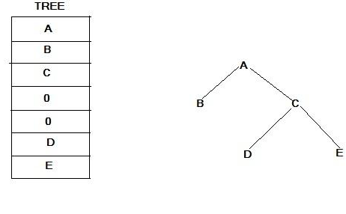
Sequential Representation
Suppose T is a complete binary tree. Then only single linear array TREE is used as follows.

Slide 278
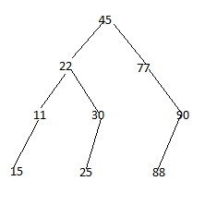
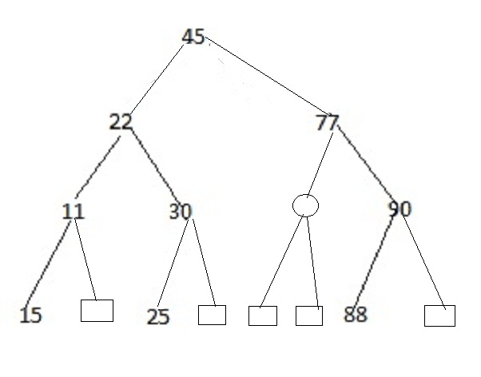
Another Example

Slide 279
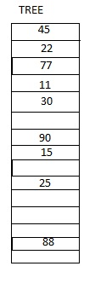
Sequential Re[presentation of Binary Tree

Slide 280
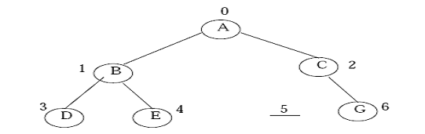
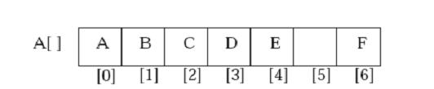
ARRAY REPRESENTATION
An array can be used to store the nodes of a binary tree.
The nodes stored in an array of memory can be accessed sequentially

Slide 281
ARRAY REPRESENTATION
How to identify
Parent, Left and Right node of any node

Slide 282
ARRAY REPRESENTATION
How to identify Parent of D stored in
Array Index n= 3

Slide 283
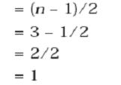
ARRAY REPRESENTATION
How to identify Parent of D stored in
Array Index n= 3
A[1] is the parent of D which is B

Slide 284
ARRAY REPRESENTATION
How to identify Left Child of C stored in
Array Index n= 2

Slide 285
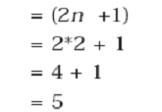
ARRAY REPRESENTATION
How to identify Left Child of C stored in
Array Index n= 2

Slide 286
ARRAY REPRESENTATION
How to identify Right Child of B stored in
Array Index n= 1

Slide 287
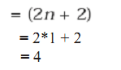
ARRAY REPRESENTATION
How to identify Right Child of B stored in
Array Index n= 1

Slide 288
ARRAY REPRESENTATION
How to determine the array Size
2^{d+1}

Slide 289
Linked Representation
The linked representation uses three parallel arrays, INFO,LEFT & RIGHT & a pointer variable ROOT.
Each node N of Y will correspond to a location K such that:
1) INFO[K] contains the data at node N.
2) LEFT[K] contains the location of left child of node N.
3) RIGHT[K] contains the location of right child of node N.
ROOT will contain location of root R of T.

Slide 290
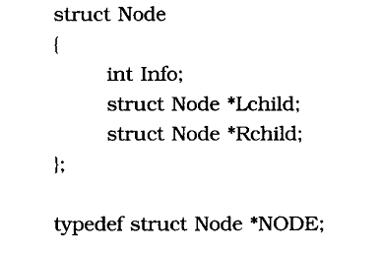
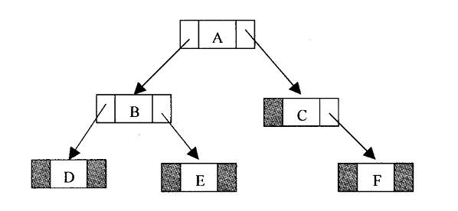
A sample representation is shown in fig.

Slide 291
Binary Search Trees (BSTs)
A binary search tree is a binary tree with a special property
For all nodes v in the tree:
All the nodes in the left subtree of v contain items less than equal to the item in v and
All the nodes in the right subtree of v contain items greater than or equal to the item in v

Slide 292
BST Example
17
13
27
9
16
20
39
11

Slide 293
Operations on BST
The operations performed on binary tree can also be applied to Binary Search Tree (BST). primitive operators performed on BST :
1. Inserting a node
2. Searching a node
3. Deleting a node
The tree traversal algorithm (pre-order, post-order
and in-order) are the standard way of traversing a binary search tree.

Slide 294
INSERTING A NODE
A BST is constructed by the repeated insertion of new nodes to the tree structure. Inserting a node in to a tree is achieved by performing two separate operations.
1. The tree must be searched to determine where the node is to be inserted.
2. Then the node is inserted into the tree.
Suppose a “DATA” is the information to be inserted in a BST.
Step 1: Compare DATA with root node information of the tree
(i) If (DATA < ROOT → Info) Proceed to the left child of ROOT
(ii) If (DATA > ROOT → Info) Proceed to the right child of ROO
Step 2: Repeat the Step 1 until we meet an empty sub tree, where we can insert the DATA in place of the empty sub tree by creating a new node.
Step 3: Exit

Slide 295
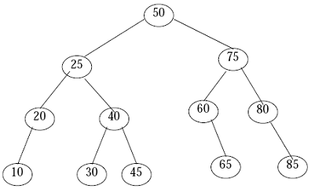
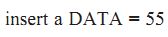
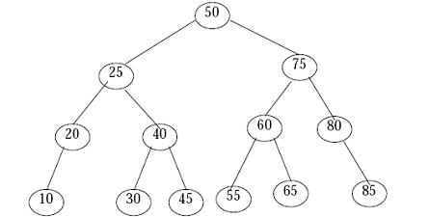

Slide 296
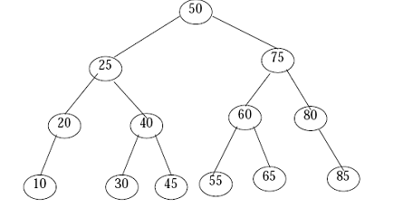
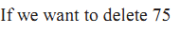
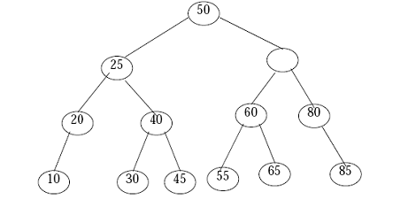
Deleting a node

Slide 297
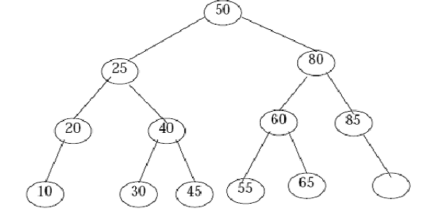
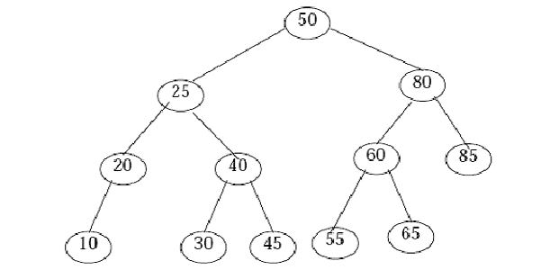

Slide 298
Exercise
Draw a Binary Search Tree that shows the result of the tree after inserting the following keys (from left to right):
The tree initially is empty.
key ={17, 9, 26, 12, 11, 7, 30, 20, 21, 10}

Slide 299
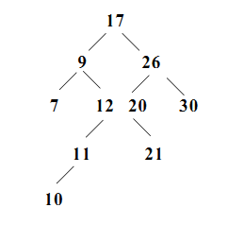
Exercise
Draw a Binary Search Tree that shows the result of the tree after inserting the following keys (from left to right):
The tree initially is empty.
key ={17, 9, 26, 12, 11, 7, 30, 20, 21, 10}

Slide 300
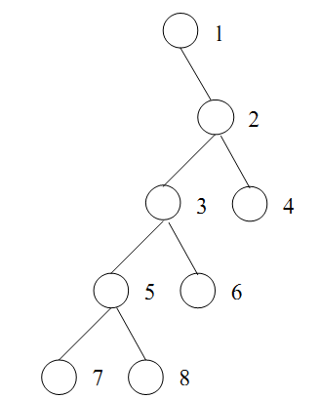
Exercise
Determine the order in which the vertices of the following binary trees will be visited under (1) preorder, (2) inorder and (3) postorder traversal.

Slide 301
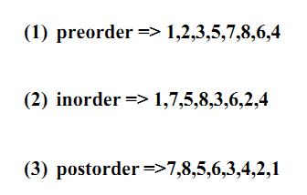
solution
Determine the order in which the vertices of the following binary trees will be visited under (1) preorder, (2) inorder and (3) postorder traversal.

Slide 302
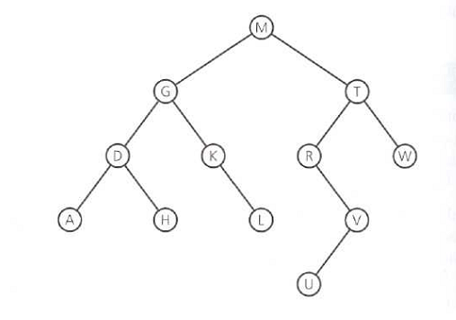
Exercise
Determine the order in which the vertices of the following binary trees will be visited under (1) preorder, (2) inorder and (3) postorder traversal.

Slide 303
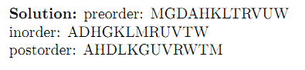
Exercise
Determine the order in which the vertices of the following binary trees will be visited under (1) preorder, (2) inorder and (3) postorder traversal.

Slide 304
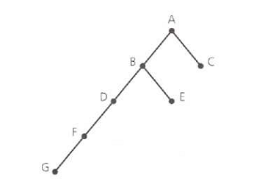
Exercise

Slide 305
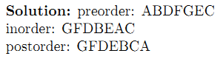
Solution

